Slide 1

What is Support Vector Machine?
Understanding the algorithm that finds the perfect dividing line

Slide 2
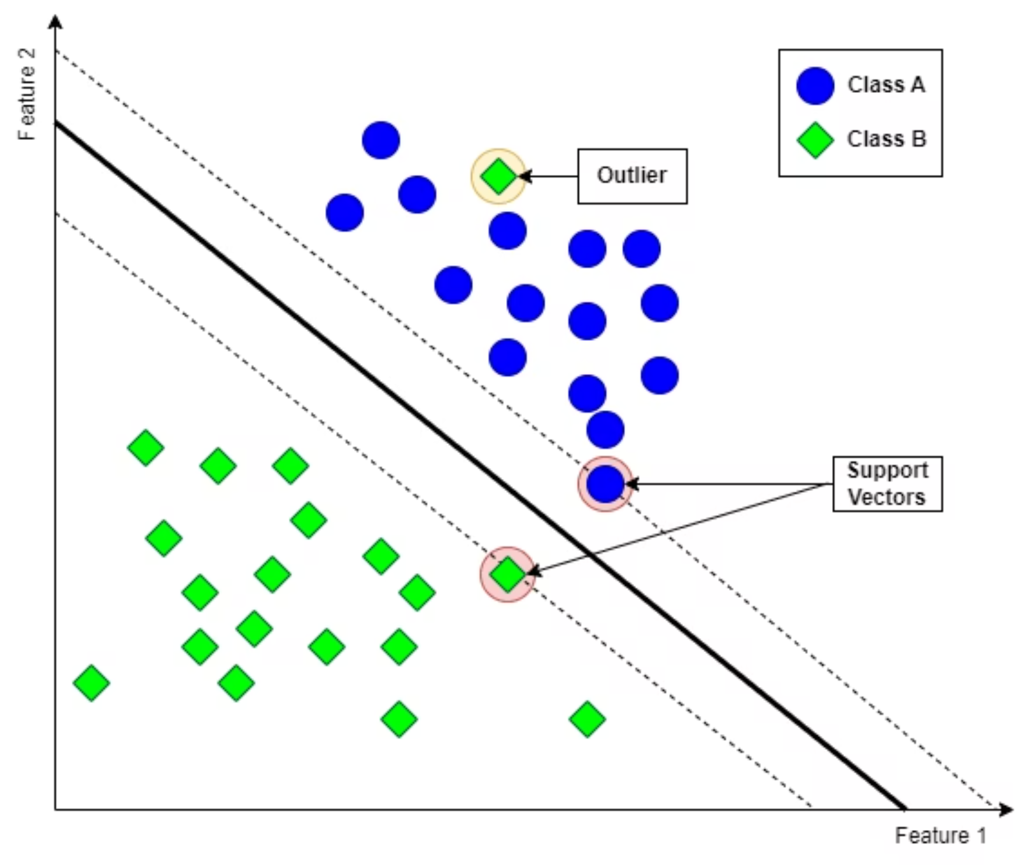
SVM in One Line
The Core Idea
SVM finds the best possible boundary between classes by maximizing the margin.
Think of it as drawing the widest possible road between two neighborhoods—the wider the road, the clearer the separation.

Slide 3
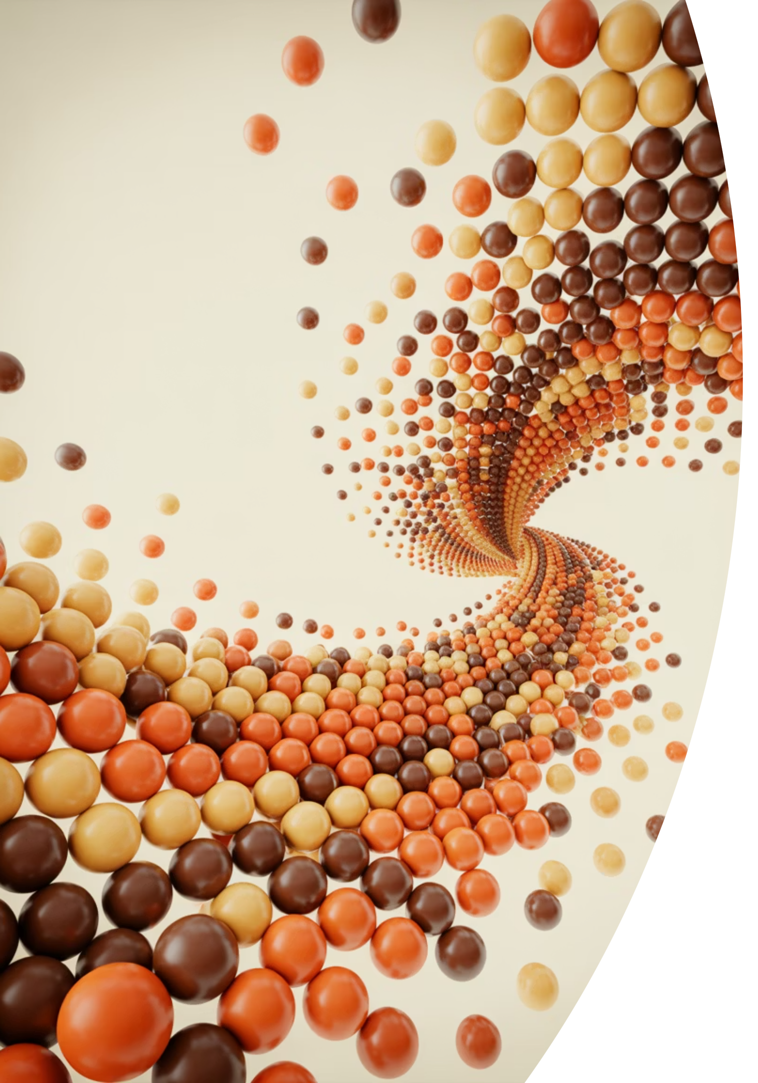
Many Lines, One Best Line
Infinite lines could separate these classes—but only one maximizes the safety zone on both sides. That's the line SVM seeks.
The Question
Which separator is most reliable?
The Answer
The one farthest from both classes

Slide 4
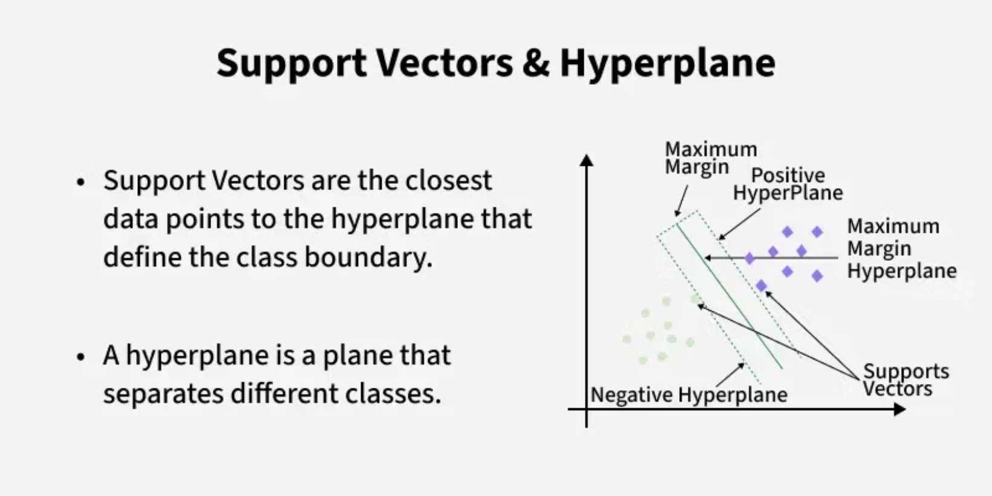
Margin Intuition
Why Margins Matter
The margin is the distance from the decision boundary to the nearest data points on either side.
Bigger margin = better generalization
A wide margin means the model is confident about its classifications and less likely to misclassify new, unseen data.

Slide 5
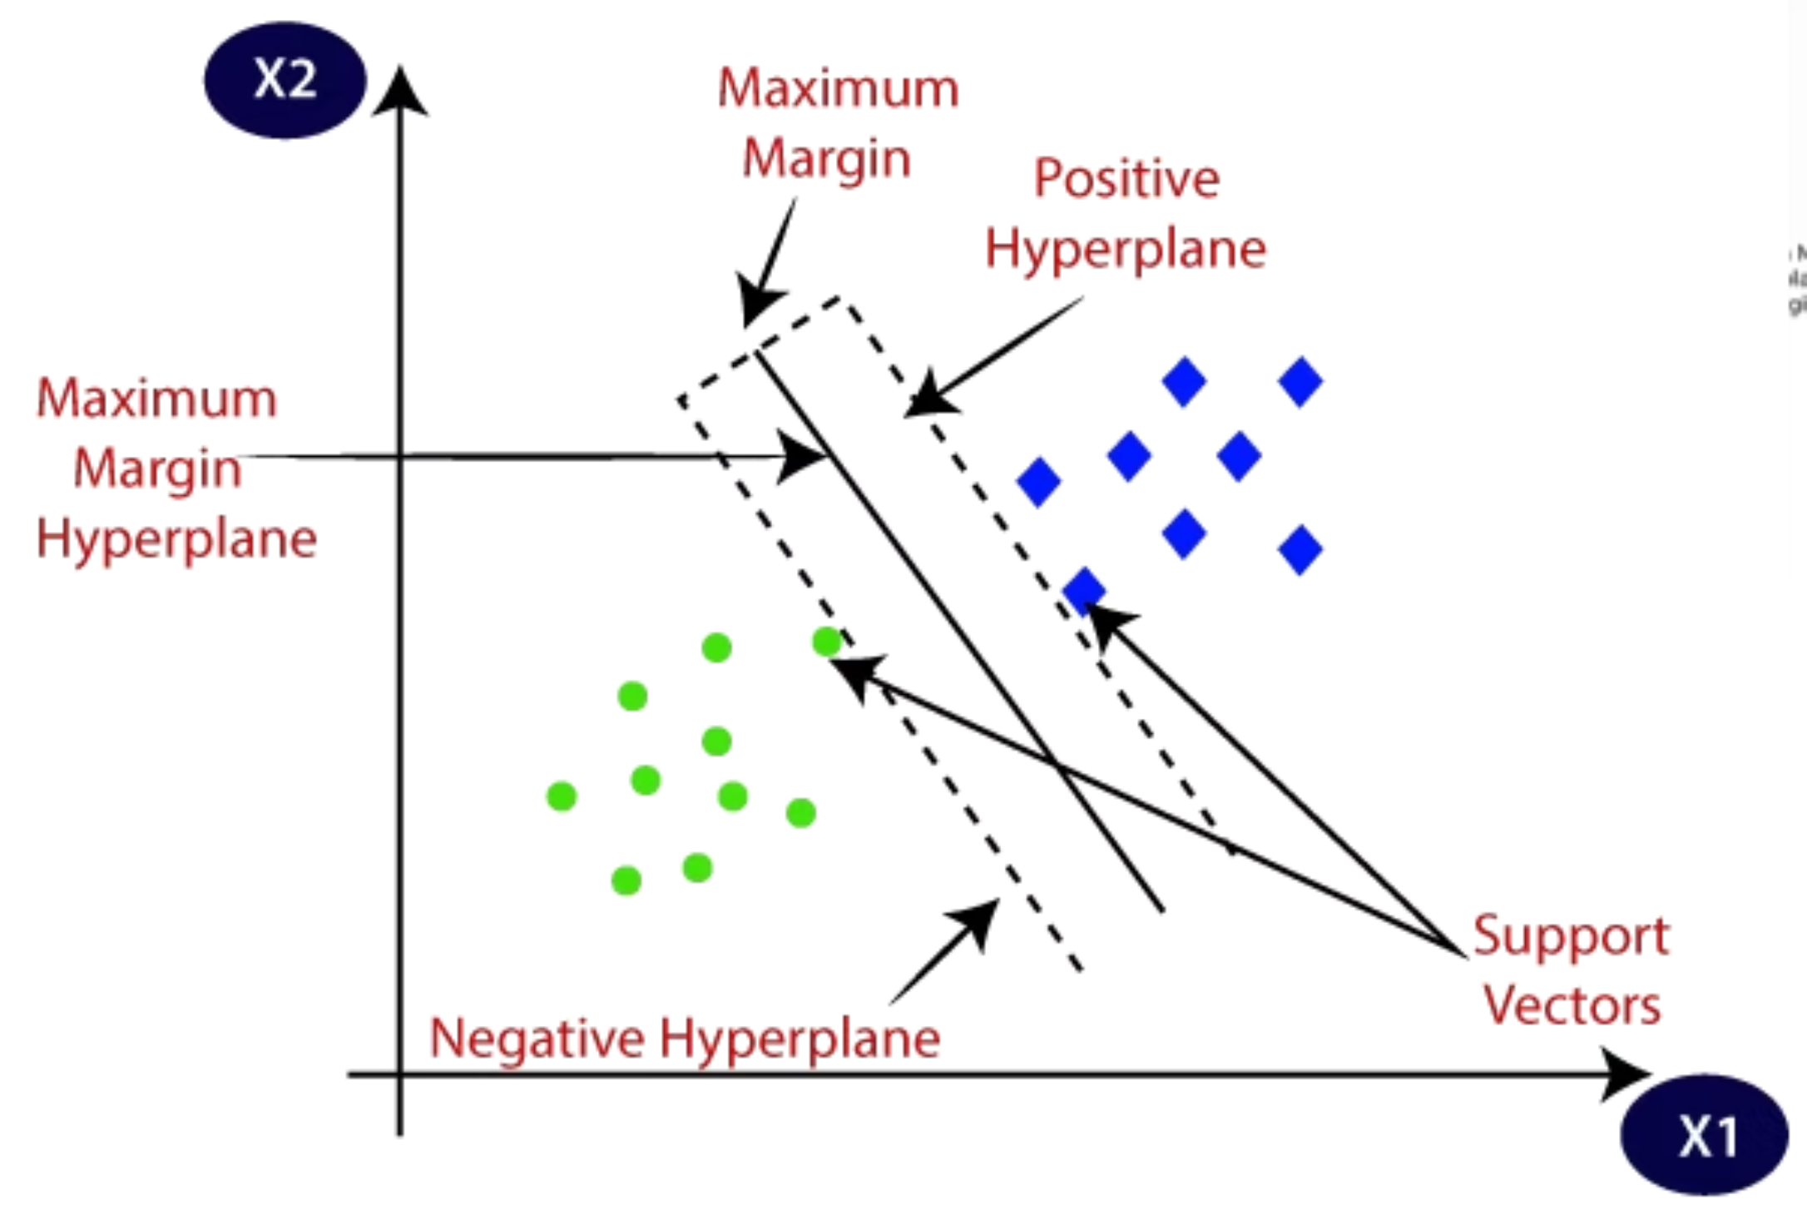
Support Vectors: The VIPs
Critical Points Only
Support vectors are the data points closest to the decision boundary—they define the margin.
Efficient Design
SVM ignores all other points. Only these boundary warriors matter for building the classifier.

Slide 6
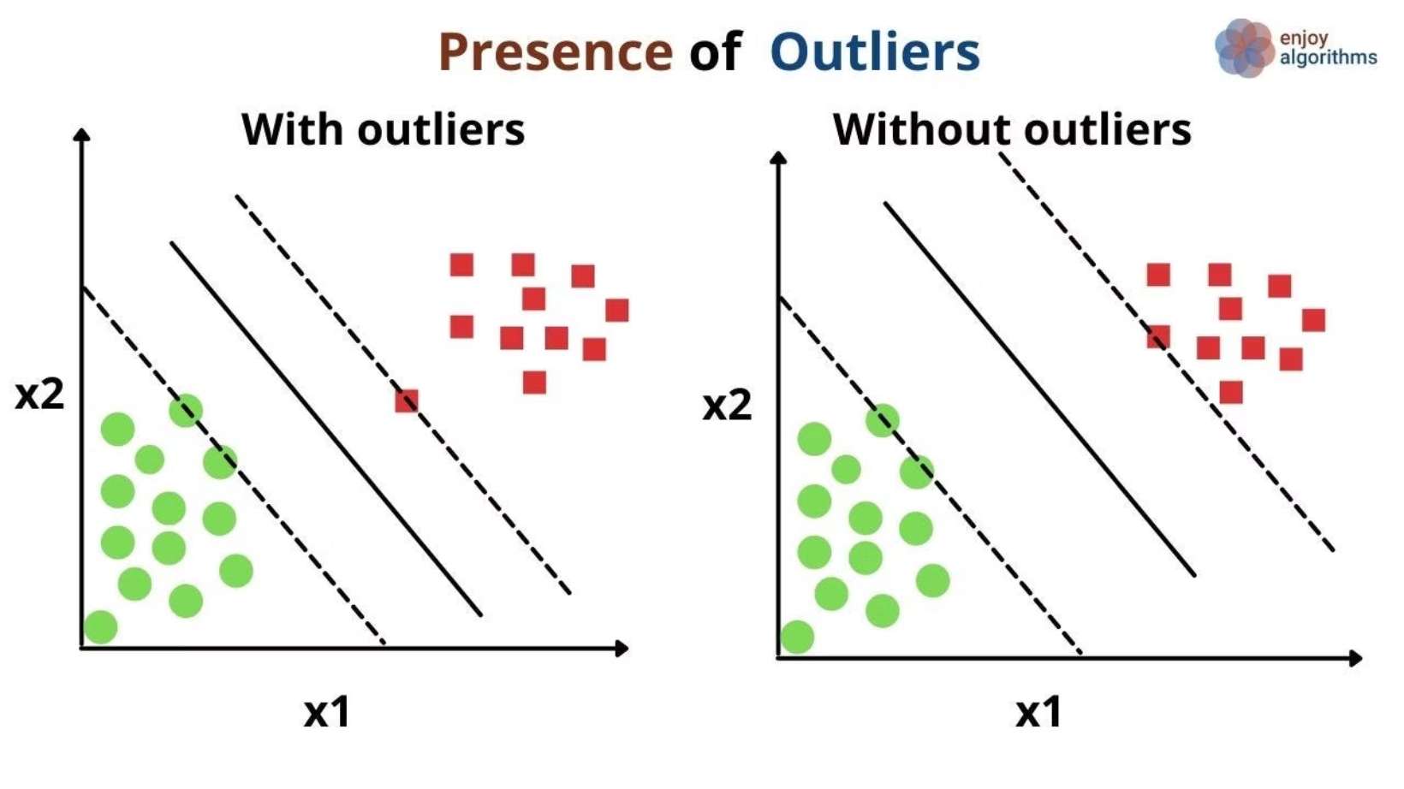
Why Only Boundary Points Matter
1
Stable Boundary
The decision line depends only on points near the margin, making it robust and focused.
2
Outlier Resistance
This image illustrates how only the support vectors (the circled points closest to the decision boundary) determine the placement of the separating hyperplane. Other data points, further away from the boundary, do not influence the model's decision, ensuring stability and robustness against outliers.
Points far from the boundary don't influence the model—SVM stays stable even when outliers exist.

Slide 7
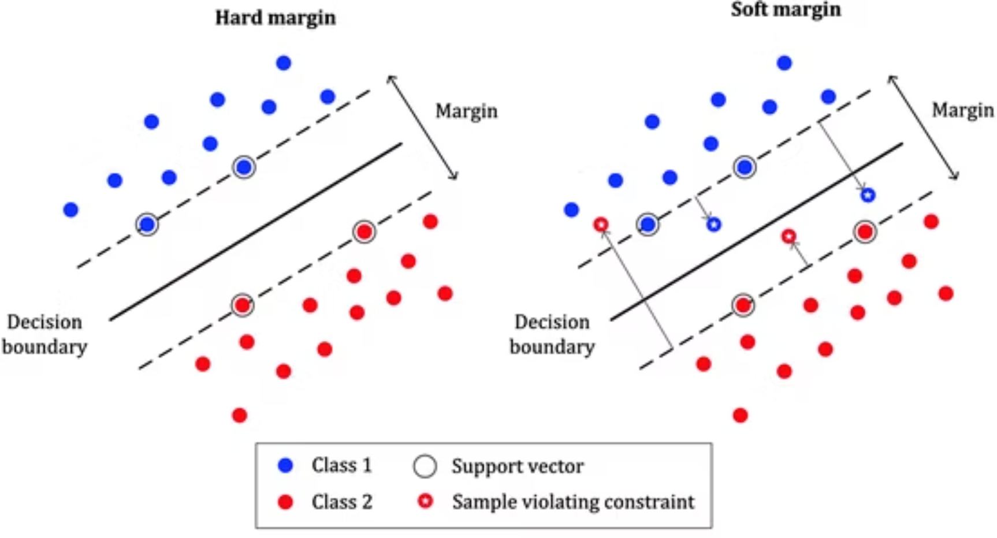
Hard vs Soft Margin
Hard Margin
Perfect separation required—no data point may cross the margin. Works only when data is perfectly separable.
Zero tolerance for mistakes
Sensitive to noise
Soft Margin
Allows small violations—some points can cross the margin. More flexible and practical for real-world data.
Tolerates a few errors
Better generalization

Slide 8

Real World Examples
Email Classification
Medical Diagnosis
Spam vs Not Spam
Malignant vs Benign
SVM learns features like word frequency, sender patterns, and links to draw a boundary between legitimate messages and junk.
Using tumor characteristics like size, texture, and shape, SVM helps doctors classify tumors with high accuracy.

Slide 9
What About Complex Data?
The Next Challenge
Not all data can be separated by a straight line. When classes are tangled or curved, we need a more powerful approach.
Coming next: How SVM handles nonlinear data using the kernel trick—transforming impossible problems into solvable ones.

